Slide 1






1
Shubh Loan
4
SmartCoin
₹ 5 Lacs
₹ 25,000
Max Amount
Max Amount
Tenure: 6-48 Months
Tenure: 62-180 Days
Interest : 40% / Year
Interest : 36% / Year
Proc. Fee: ₹ 0
Proc. Fee: ₹ 2% - 4%
2
5
Money View
Home Credit
₹ 5 Lacs
₹ 2.5 Lacs
Max Amount
Max Amount
Tenure: 3-60 Months
Tenure: 12-51 Months
Interest : 33% / Year
Interest : 50% / Year
Proc. Fee: ₹ 2.5% - 4%
Proc. Fee: ₹ 3%
3
6
Kissht
LazyPay
₹ 1 Lacs
₹ 1 Lacs
Max Amount
Max Amount
Tenure: 3-24 Months
Tenure: 3-24 Months
Interest : 31% / Year
Interest : 32% / Year
Proc. Fee: ₹ 500 + GST
Proc. Fee: ₹ 2%

Slide 2






7
iCredit
10
RupeeRedee
₹ 50,000
₹ 25,000
Max Amount
Max Amount
Tenure: 91-120 Days
Tenure: 3-12 Months
Interest : 24% / Year
Interest : 40% / Year
Proc. Fee: ₹ 0
Proc. Fee: ₹ 499 - ₹ 999
8
11
IDFC Loan
MOMO Loan
₹ 40 Lacs
₹ 30,000
Max Amount
Max Amount
Tenure: 12-84 Months
Tenure: 15-60 Days
Interest : 20% / Year
Interest : 36% / Year
Proc. Fee: ₹ 0
Proc. Fee: ₹ 499 + GST
9
12
MoneyTap
Sahukar
₹ 5 Lacs
₹ 5,000
Max Amount
Max Amount
Tenure: 2-36 Months
Tenure: 30-90 Days
Interest : 24.30% / Year
Interest : 36% / Year
Proc. Fee: ₹ 0
Proc. Fee: ₹ 0

Slide 3

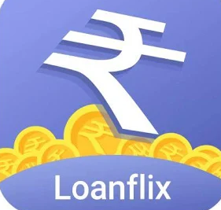




13
Krdeitzy
16
LoanFlix
₹ 1 Lacs
₹ 25,000
Max Amount
Max Amount
Tenure: 3-12 Months
Tenure: 3-12 Months
Interest : 29.95% / Year
Interest : 36% / Year
Proc. Fee: ₹ 0
Proc. Fee: ₹ 0
14
17
Mi Credit
NanoCredit
₹ 2 Lacs
₹ 50,000
Max Amount
Max Amount
Tenure: 3-24 Months
Tenure: 91- 120 Days
Interest : 35% / Year
Interest : 33% / Year
Proc. Fee: ₹ 1.99% + GST
Proc. Fee: ₹ 90- 820 + GST
15
18
FundPI
CashPost
₹ 25,000
₹ 15,000
Max Amount
Max Amount
Tenure: 3-12 Months
Tenure: 91-180 Months
Interest : 28.88% / Year
Interest : 36% / Year
Proc. Fee: ₹ 499 + GST
Proc. Fee: ₹ 54 - ₹ 540 + GST

Slide 4
Customer care
ICICI Bank 1860 120 7777
Tata Capital 1860 267 6060
Qbera 1800 419 8121 / +91 9513555475
Retra +919819314949
LendBox +91-7291027919
Upward 1860 267 4777
Muthhot finance +91-484-2396478
Phone Par Loan 074280 58539
Faircent Loan 0120-4659902
Avil Finance +91-8880428245
Payme india +91-1206361900
Early salary 020-67639797

Slide 5
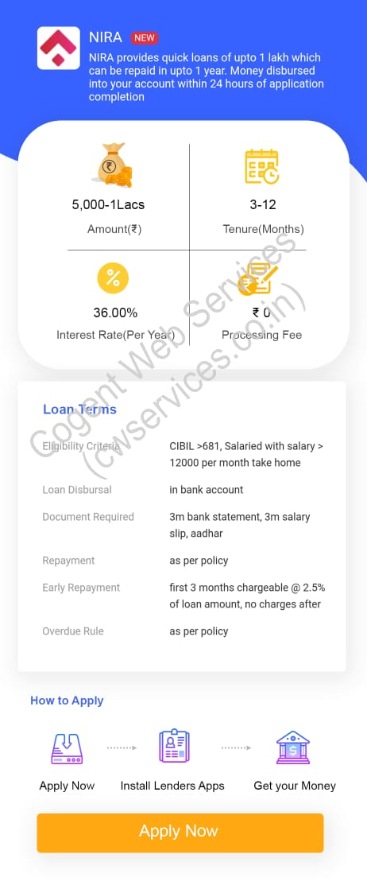

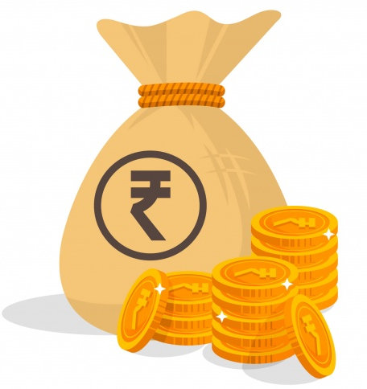



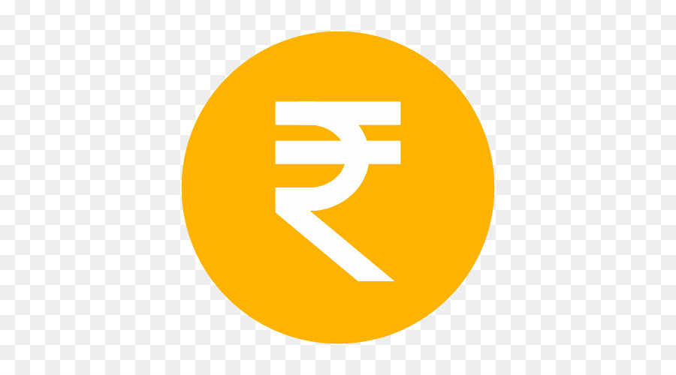



(Back Button) Add on Every Page…
Preview page this missing
< Personal Loan Offers
Shubh Loan
Digital platform that provide Loan
25,000-5 Lacs
6-48
Amount (₹ )
Tenure (Months)
26.00% - 40.00%
₹ 0
Interest Rate (Per Year)
Processing Fee
Loan Terms
Eligibility Criteria Salaried employees with a
Min net salary of <15K per
month
Loan Disbursal Bank Account
Document Required PAN, Salary Slip, 3 months
bank statements and Address
Proof, Aadhar E-Sign
Repayment NEFT, UPI, Debit Card, Net
banking
Early Repayment Monthly Interest Payable,
No Prepayment Fees
Overdue Rule Penalty charges
Available Cities Bengaluru, Mumbai, Chennai,
Hyderabad, Delhi NCR, Pune,
Ahmadabad, Chandigarh,
Jaipur, Nashik, Mysore and
Coimbatore.
Customer Care +91 9019900199
Add full under line … Loan Term & How to apply
How to Apply
Swipe apply icon to install lenders Apps
In all page in our list
Apply Now
Install Lenders Apps
Get your Money
Apply Now

Slide 6
Money View
Instant Personal Loan in just a few hours
10,000-5 Lacs
3-60
Amount (₹ )
Tenure (Months)
10.33% - 25.00%
₹ 2.5% - 4%
Interest Rate (Per Year)
Processing Fee
Loan Terms
Eligibility Criteria Salaried employees& Self
Employee with a Min net
income of 13.5K per month,
Income should be received in
a bank, Min Cibil score of 650
or Experian score of 750
Loan Disbursal Salary Bank Account
Document Required PAN or Aadhar Card Salary
Slip, 3 months bank
statements in pdf and
Address Proof
Repayment NEFT, UPI, Debit Card, Net
banking
Early Repayment Monthly Interest Payable,
No Prepayment Fees
Overdue Rule Penalty charges
Customer Care 080 4569 2002
How to Apply
Apply Now
Install Lenders Apps
Get your Money
Apply Now

Slide 7
Kissht
EMI without credit card - 0% EMI Finance
3,000-1 Lacs
3-24
Amount (₹ )
Tenure (Months)
14.0% - 31.0%
₹ 250 to ₹ 500
Interest Rate (Per Year)
Processing Fee
Loan Terms
Eligibility Criteria Salaried employees with a
Min net salary of 12K per
month, Minimum age 21
year Complete.
Loan Disbursal Salary Bank Account
Document Required PAN, Salary Slip, 3 months
bank statements and Address
Proof, 1 Signed ECS Form for
auto-debit
Repayment NEFT, UPI, Debit Card, Net
banking
Early Repayment Monthly Interest Payable,
No Prepayment Fees
Overdue Rule Penalty charges on customer
defaults or delays
Customer Care 022-62820570
How to Apply
Apply Now
Install Lenders Apps
Get your Money
Apply Now

Slide 8
Nxnmm.
SmartCoin
Get Instant Money & Quick Loans
1,000-25,000
62-180
Amount (₹ )
Tenure (Days)
26.00% -36.00%
₹ 2% -4%
Interest Rate (Per Year)
Processing Fee
Loan Terms
Eligibility Criteria Minimum monthly income of
Rs 15000/- Per months
Loan Disbursal In the customer’s Any Bank
account
Document Required Application Form, KYC, Salary
Slip and Bank Statement,Selfie
Repayment From the customer's salary
account (NACHe)
Early Repayment Zero charges on Part Pre-
Payment
Overdue Rule AS PER THE POLICY
How to Apply
Apply Now
Install Lenders Apps
Get your Money
Apply Now

Slide 9
Nxnmm.
Home Credit
Instant Personal Loan and Ujjwal Card
10,000-2.5Lacs
12-51
Amount (₹ )
Tenure (Months)
24.00-50.00%
3%
Interest Rate (Per Year)
Processing Fee
Loan Terms
Eligibility Criteria Minimum Income : 15K net
per month; minimum age :
21 years
.
Loan Disbursal E-Sin Agreement, KYC
Document Required 3 month salary slip, 6 month
bank statement
Repayment NACH - monthly repayment
Early Repayment No prepayment for first
6 months
Overdue Rule DPD basis EMI being missed
on the due date
Customer Care +91 - 124 - 662 - 8888
How to Apply
Apply Now
Install Lenders Apps
Get your Money
Apply Now

Slide 10
Nxnmm.
LazyPay
Instant Personal Loan Online App
10,000-1Lacs
3-24
Amount (₹ )
Tenure (Months)
15.00-32.00%
2%
Interest Rate (Per Year)
Processing Fee
Loan Terms
Eligibility Criteria Minimum Income : 15K net
per month; minimum age :
21 years
.
Loan Disbursal E-Sin Agreement, KYC
Document Required 3 month salary slip, 6 month
bank statement, Photo of
your signature, Current
address proof, KYC
Repayment Net banking, debit card,
credit card or UPI.
Overdue Rule DPD basis EMI being missed
on the due date,
How to Apply
Apply Now
Install Lenders Apps
Get your Money
Apply Now

Slide 11
iCredit Loan
Instant Personal Loan Mini Cash Loan App
5,000-50,000
91-120
Amount (₹)
Tenure (Days)
20.00% - 24.00%
₹ 0
Interest Rate (Per Year)
Processing Fee
Loan Terms
Eligibility Criteria Salaried employees with a
Min net salary of 14K per
month
Loan Disbursal Salary Bank Account
Document Required PAN, Salary Slip, 3 months
bank statements and Address
Proof
Repayment NEFT, UPI, Debit Card, Net
banking
Early Repayment Monthly Interest Payable,
No Prepayment Fees
Overdue Rule Penalty charges
Customer Support +91 9953020829
Eligible Cities Delhi, Jaipur, Indore, Mumbai,
Pune, Chennai, Cochin,
Hyderabad, Lucknow,
Vijaywada, Bangalore,
Mysore, Mangalore and other
cities
How to Apply
Apply Now
Install Lenders Apps
Get your Money
Apply Now

Slide 12
Nxnmm.
IDFC First Bank
Loans App, your one stop solution
1Lacs - 40Lacs
12-84
Amount (₹ )
Tenure (Months)
10.75-20.00%
0%
Interest Rate (Per Year)
Processing Fee
Loan Terms
Eligibility Criteria Minimum Income : 15K net
per month; minimum age :
21 years
.
Loan Disbursal Customer Bank Account
Document Required PAN/Form 60, 3 month salary
slip, 6 month bank statement,
Photo of your signature,
Current address proof, KYC
Repayment Net banking, debit card,
credit card or UPI.
Overdue Rule DPD basis EMI being missed
on the due date.
Customer Care 18605009900
How to Apply
Apply Now
Install Lenders Apps
Get your Money
Apply Now

Slide 13
Nxnmm.
MoneyTap
Credit - Better Than Personal Loan Apps
3,000 - 5Lacs
2-36
Amount(₹ )
Tenure(Months)
13.00-24.30%
0%
Interest Rate (Per Year)
Processing Fee
Loan Terms
Eligibility Criteria Minimum Income : 20K net
per month; minimum age :
21 years
Loan Disbursal Customer Bank Account
Document Required Aadhar number, Identity
proof, Address proof, passport
photo/selfie, Aadhaar card.
E-sign, Pan Card
Repayment Net banking, debit card,
credit card or UPI.
Overdue Rule DPD basis EMI being missed
on the due date,
Available Cities Delhi, Noida, Greater Noida,
Faridabad, Ghaziabad, Kochi
Gurgaon, Mumbai, Navi
Mumbai, Thane, Pune,
Kolhapur, Nagpur, Nashik,
Hyderabad & Secunderabad,
Tirupati, Lucknow, Mohali,
Ahmedabad, Vadodara Surat,
Anand, Rajkot, Bharuch, Salem
Haridwar, Dehradun, Chennai,
Coimbatore, Erode, Bangalore,
Mangalore, Jaipur, Jodhpur,
Kolkata,Chandigarh, Indore,
Panchkula, Ambala, Bhopal,
Visakhapatnam (Vizag),
Vijayawada,
How to Apply
Apply Now
Install Lenders Apps
Get your Money
Apply Now

Slide 14
Nxnmm.
Rupee Redee
financial services platform
5,000 -25,000
3-12
Amount (₹ )
Tenure (Months)
36.00% -40.00%
₹ 499 - ₹ 999
Interest Rate (Per Year)
Processing Fee
Loan Terms
Eligibility Criteria Minimum Income : 15K net
per month; minimum age :
21 years
.
Loan Disbursal Customer Bank Account
Document Required 3 month salary slip, 6 month
bank statement, Photo of
your signature, Current
address proof, Latest
Photograph, PAN Card, Access
to bank account details
Repayment Net banking, debit card,
credit card or UPI.
Overdue Rule Penalty according to days past
due date.
Customer Care 0124-4847111
How to Apply
Apply Now
Install Lenders Apps
Get your Money
Apply Now

Slide 15
Nxnmm.
MOMO Loan
100% Online process & Fast approval
3,000 -30,000
15-60
Amount (₹ )
Tenure (Days)
24.00% -36.00%
₹ 499 + GST
Interest Rate (Per Year)
Processing Fee
Loan Terms
Eligibility Criteria Minimum Income : 15K net
per month; minimum age :
21 years
.
Loan Disbursal Customer Bank Account
Document Required 3 month salary slip, 6 month
bank statement, Photo of
your signature, Current
address proof, Latest
Photograph, PAN Card, Access
to bank account details
Repayment Net banking, debit card,
credit card or UPI.
Overdue Rule EMI being missed on the due
date.
Customer Care 01836670970
How to Apply
Apply Now
Install Lenders Apps
Get your Money
Apply Now

Slide 16
Nxnmm.
Sahukar
Pocket money loans for Collage students
5,00 -5,000
30-90
Amount (₹ )
Tenure (Days)
30.00% -36.00%
₹ 0
Interest Rate (Per Year)
Processing Fee
Loan Terms
Eligibility Criteria Collage Student, minimum
age : 21 years
Loan Disbursal Bank Account/Paytm Wallet
Document Required Collage Id Proof, Photo of
your signature, Current
address proof, PAN Card
Repayment Net banking, debit card,
credit card or UPI.
Overdue Rule EMI not missed on the due
date.
How to Apply
Apply Now
Install Lenders Apps
Get your Money
Apply Now

Slide 17
Nxnmm.
Kreditzy
Instant Loan App Online Personal Loan
1,000 -100,000
91-365
Amount (₹ )
Tenure (Days)
17.00% -29.95%
₹ 0
Interest Rate (Per Year)
Processing Fee
Loan Terms
Eligibility Criteria Minimum Income : 17K net
per month; minimum age :
21 years
.
Loan Disbursal Customer Bank Account
Document Required PAN Card, Aadhar Card ,Bank
Account Details, Current
address proof, Selfie, E-sign
the loan agreement.
Repayment Net banking, debit card,
credit card or UPI.
Overdue Rule EMI being missed on the due
date.
Customer Care +918044292500
Available City All India PAN
How to Apply
Apply Now
Install Lenders Apps
Get your Money
Apply Now

Slide 18
Nxnmm.
Mi Credit
personal loan platform from Xiaomi
1,000 -200,000
3-24
Amount (₹ )
Tenure (Months)
11.35% -35.00%
1.99% + GST
Interest Rate (Per Year)
Processing Fee
Loan Terms
Eligibility Criteria Minimum Income : 18K net
per month; minimum age :
21 years
.
Loan Disbursal Customer Bank Account
Document Required PAN Card, Aadhar Card ,Bank
Account Details, Current
address proof, Selfie, E-sign
the loan agreement.
Repayment Net banking, debit card,
credit card or UPI.
Overdue Rule EMI being missed on the due
date.
Customer Care 1800-258-6286
Available City All India PAN
How to Apply
Apply Now
Install Lenders Apps
Get your Money
Apply Now

Slide 19
Nxnmm.
FundPI
Fast approval & Digital agreement
3,000 -25,000
3-12
Amount (₹ )
Tenure (Months)
17.88% -28.88%
₹ 499 + GST
Interest Rate (Per Year)
Processing Fee
Loan Terms
Eligibility Criteria Minimum Income : 16K net
per month; minimum age :
21 years
.
Loan Disbursal Customer Bank Account
Document Required 3 month salary slip, 6 month
bank statement, Current
address proof, Latest
Selfie, PAN Card, Access
to bank account details
Repayment Net banking, debit card,
credit card or UPI.
Overdue Rule EMI being missed on the due
date.
Customer Care 07066188088
How to Apply
Apply Now
Install Lenders Apps
Get your Money
Apply Now

Slide 20
LoanFlix
EMI without credit card - 0% EMI Finance
1,000-2 Lacs
3-12
Amount (₹ )
Tenure (Months)
24.0% - 36.0%
₹ 0
Interest Rate (Per Year)
Processing Fee
Loan Terms
Eligibility Criteria Proof of fixed income,
Minimum age 21
year Complete.
Loan Disbursal Customer Bank Account
Document Required PAN, Salary Slip, 3 months
bank statements and Address
Proof.
Repayment NEFT, UPI, Debit Card, Net
banking
Early Repayment Monthly Interest Payable,
No Prepayment Fees
Overdue Rule Penalty charges on customer
defaults or delays
How to Apply
Apply Now
Install Lenders Apps
Get your Money
Apply Now

Slide 21
NanoCredit
100% digital application process
1,000 - 50,000
91-120
Amount (₹ )
Tenure (Days)
24.0% - 33.0%
₹ 90 - ₹820 + GST
Interest Rate (Per Year)
Processing Fee
Loan Terms
Eligibility Criteria Monthly income Source,
Minimum age 21 year
Complete, No credit history
required
Loan Disbursal Customer Bank Account
Document Required PAN, Aadhar Card, Selfie
Address Proof.
Repayment NEFT, UPI, Debit Card, Net
banking
Early Repayment Monthly Interest Payable,
No Prepayment Fees
Overdue Rule Penalty charges on customer
defaults or delays
Customer Care 18005721618 / 0120-6027801
How to Apply
Apply Now
Install Lenders Apps
Get your Money
Apply Now

Slide 22
Nxnmm.
CashPost
Mobile based personal loans platform
3,000 -15,000
91-180
Amount (₹ )
Tenure (days)
24.00% -36.00%
₹ 54 - ₹ 540 + GST
Interest Rate (Per Year)
Processing Fee
Loan Terms
Eligibility Criteria Monthly source of income/
Independent business man minimum age : 21 years.
Loan Disbursal Customer Bank Account
Document Required PAN, Aadhar Card, Selfie
Address Proof.
Repayment Net banking, debit card,
credit card or UPI.
Overdue Rule Penalty according to days past
due date.
Customer Care 09711347553
How to Apply
Apply Now
Install Lenders Apps
Get your Money
Apply Now

